Slide 1
Ethiopia small Ruminant Value Chain Transformation-SmaRT
Author A. Tigabie
Position: CRP Country Program Coordinator
Email A.Tigabie@cgiar.org
Date6/17/2020

Slide 2
Importance of sheep and goat enterprises in Ethiopia
Agriculture provides sustenance for more than 80% of the population and accounts for 34.9% of GDP and 83.9% of total exports (NBE, 2018)
Globally sheep and goat serve as sources of food and nonfood products and serve as means of risk mitigation during crop failures, property security, monetary saving, and investment in addition to many other socio-economic and cultural functions (Solomon et al., 2010, Shenkute, 2009).
At total of about 60 million (30.70 and 30.20 million sheep and goat, respectively) of various breeds available in Ethiopia (CSA, 2018)
Sheep and goats are kept for multiple benefits including milk, meat, fiber, leather, and manure.
In a socio-economic context, these The contributions to food production, the socio-economic wellbeing and stability of poor farm households, and a variety of services are often overlooked and underestimated (Devendra, 2006)
Notes:
Discuss on one of the enterprises:
How much does it contribute to GDP?
How many people are involved in the country?

Slide 3
Importance of sheep and goat enterprises in Ethiopia…
Livestock sector contributes up to 25.6% of agricultural GDP and 10.5% of total Ethiopian foreign exchange earnings (NBE, 2018)
Sheep and goat are more important in marginal dry areas of the country as crop productivity and maintaining large animal is limited because of the environment
Major income source
Larger flock size per household
Important source of animal source food (milk, meat)
Some breeds provide wool
Manure as fertilizer and fuel source
Cultural values
Means of risk mitigation, saving
In food insecure areas (pastoral and degraded areas), livestock not only provide income but also contribute significantly to the food and nutritional security of entire communities
Notes:
Discuss on one of the enterprises:
How much does it contribute to GDP?
How many people are involved in the country?

Slide 4
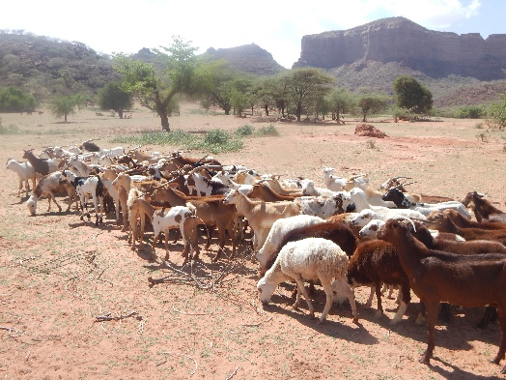
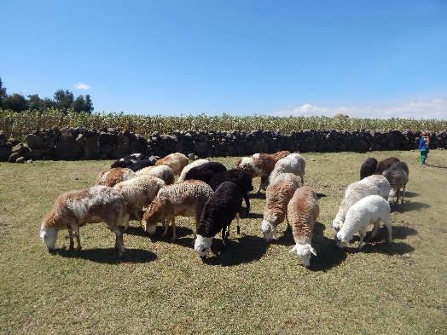
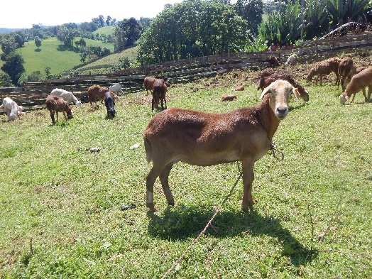
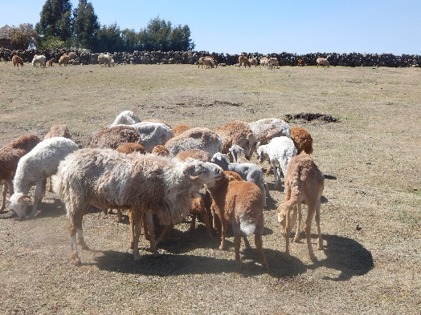
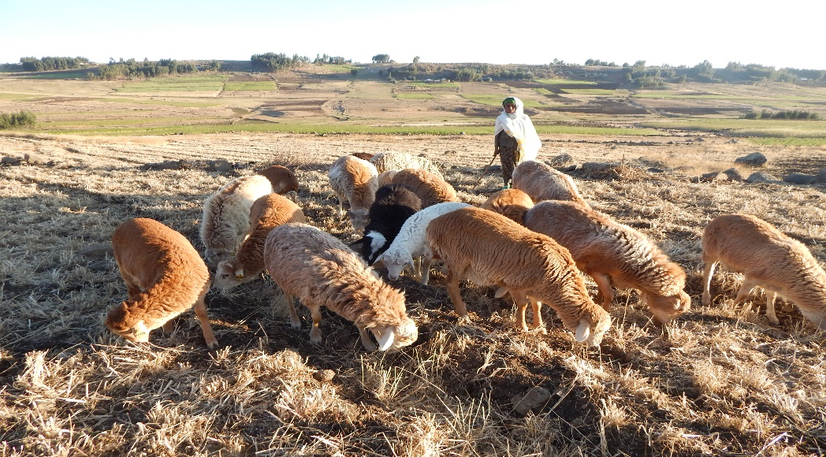
Livestock master plans and future projections
The major policies and strategies that guide the transformation of its livestock sector include
The Growth and Transformation Plan-II (2015–2020),
The Agricultural Development Led Industrialization (since 1995),
The Livestock Master Plan (2015–2020),
Sheep and goat: projected 20% of live weight gain by the livestock master plan over 20 years
The Climate Resilient Green Economy Strategy (2015–2030).
Notes:
Name the key environmental challenges from the livestock sector ( 2 should suffice)
Are there ways to mitigate these challenges (e.g better feeds, biogas etc), current innovations/technologies

Slide 5
Livestock & Environment opportunities and challenges
Opportunities
Large number of sheep and goat with diversified agroecology suitable for livestock production with different breed types
Growing global and local demand for animal source food
Availability of technologies to enhance productivity (CBBP, fattening, health, market linkage and so on)
Huge government extension service ready to contribute for the sector
Growing attention for the sector
Export potential increasingly important player in livestock trade.
The increasing demands for livestock products inline with population growth and rising per capita income
Red meat consumption will grow by about 276% from 775,000 tons in 2013 to 2.9 million tons, with an average annual consumption of 24.5 kg per year. Meat deficit of about 1.3 million, 53% MT
Milk consumption will grow by 127% from 5 billion liters in 2013 to 11 billion liters.
Domestic milk production expected to cover more than 71% of the total consumption requirement representing a production-consumption gap of 3.2 billion liters. Milk deficit of about 3,185 million litres, 29% of milk in 2028.
Notes:
Name the key environmental challenges from the livestock sector ( 2 should suffice)
Are there ways to mitigate these challenges (e.g better feeds, biogas etc), current innovations/technologies

Slide 6
Livestock & Environment opportunities and challenges…
Challenges
Limited resources, low investment, domination of extensive production systems, low production level this leads little benefits from its cattle resources.
Small ruminants kept in extensive and tradition production system
Low productivity and the country derives low benefit
Natural resources depletion and climate change including erosion, soil degradation, deforestation
Shortage of grazing land
Competitions for land, feed and water and other resources is becoming severe.
Increased consumption of animal source foods and high level of production pose an immense environmental challenge,
Substantial increases in livestock production have negative externalities on the environment, GHG emissions,, and water pollution.

Slide 7

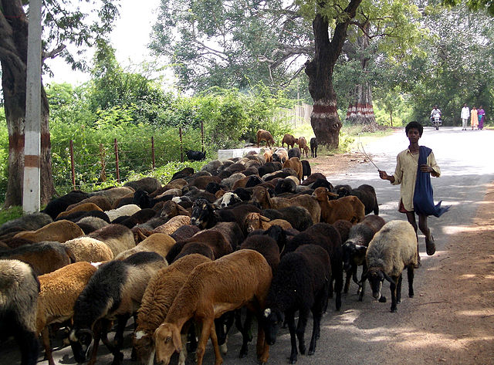
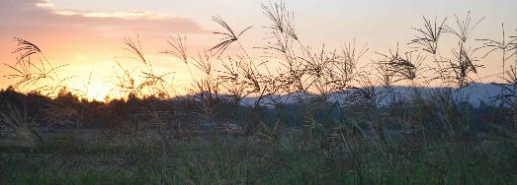
Livestock production is implemented in the arid, semi arid and highland areas
Breeds found in Ethiopia with different agroecology’s (Gizaw et al., 2007) nine sheep, (Mekuriaw, 2016) seven goat breeds kept in diverse hot arid and semiarid areas to the cold humid highland agro-ecologies (Workneh et al., 2003; Kosgey, 2004).
Land degradation with restoration capacities of natural resources,
Poor pasture quality, each with downstream effects on water flows and quality
Rangelands provide food for animals affected by agrochemicals that affects the quality of livestock products consequently affects people health
Community grassland rangeland management needs priority

Slide 8
Thank you!
Author Abiro T.
Position CRP Country Program Coordinator
Email A.Tigabie@cgiar.org

